Slide 1
EVEL Library & Test Collector
December 9th, 2016
For Question Please Contact
Alok Gupta
+1 (732)-420-7007
ag1367@att.com

Slide 2
Agenda
Installation on Ubuntu
Build
EVEL library
Documentation
Unit Test
Demo

Slide 3
Ubuntu + Packages
Ubuntu Installation
Started with a vagrant image ‘ubuntu/trusty64’, added xfce4
Turned on file sharing to /vagrant, and loaded delivery files there.
Install required packages
To browse documentation
sudo apt-get install -y firefox
To build EVEL library
sudo apt-get install -y libcurl4-openssl-dev
sudo apt-get install -y python-pip
To run collector.py
sudo pip install jsonschema
sudo pip install functools32
To run test_control.py
sudo pip install requests

Slide 4
DOxygen
To enable building of documentation
Manual installation of doxygen required:
wget http://ftp.stack.nl/pub/users/dimitri/doxygen-1.8.12.linux.bin.tar.gz
Unpack it
Configure
sudo make install

Slide 5
Unpack Delivery
Unpack EVEL
mkdir ~/evel
mkdir ~/evel/evel-library
cd ~/evel/evel-library
cp /vagrant/evel-library-package.tgz .
tar xvf evel-library-package.tgz
rm evel-library-package.tgz
Unpack COLLECTOR
mkdir ~/evel
mkdir ~/evel/evel-test-collector
mkdir ~/evel/evel-test-collector/logs
cd ~/evel/evel-test-collector
cp /vagrant/evel-test-collector.tgz .
tar xvf evel-test-collector.tgz
rm evel-test-collector.tgz
cd ~/evel/evel-test-collector/code/collector

Slide 6
Environment / Build
Configure environment:
Add to ~/.bashrc:
export LD_LIBRARY_PATH=/home/vagrant/evel/evel-library/libs/x86_64
export PATH=$PATH:/home/vagrant/evel/evel-library/output/x86_64
You should now be able build and run
cd ~/evel/evel-library/bldjobs
make
make docs
And browse the documentation:
/home/vagrant/evel/evel-library/docs/source/evel/html/index.html

Slide 7
Demo
Username and Password
Mobile Flow
Service Events
Signaling
Syslog
State Change
Other
Event Throttling
Measurement Interval

Slide 8
Running The Collector
The configuration change in the collector:
In the [windows] section, add the username and password:
vel_username = will
vel_password = pill
The command to run the collector:
python collector.py -v --config ../../config/collector.conf --section windows

Slide 9
Running The DEMO
The command to run the demo application:
evel_demo --fqdn localhost --port 30000 --verbose -c 20 -u will -w pill
This runs 20 cycles, each cycle generating a set of events
The demo prints comments about changes in behaviour for a given cycle (i.e. 1 - 20), for example:
1 - Resetting throttle specification for all domains
5 - Switching measurement interval to 5s
9 - Suppressing service event domain
12 - Switching measurement interval to 10s
Increasing the number of cycles repeats the 20-cycle pattern.

Slide 10
Revised Demo 03/11/2016
Using ‘evel_training’ to demonstrate scenarios
05 - Raise Fault – without username and password
06 - Raise Fault – with username and password
07 - Raise Measurement
08 - Raise Mobile Flow
09 - Raise State Change
10 - Raise Syslog
11 - Raise Other
12 - Raise Fault – suppress fields
13 - Raise Fault – suppress name-value pairs
14 - Adapting to measurement interval
15 – Raise Signaling
16 – Raise Service Event

Slide 11
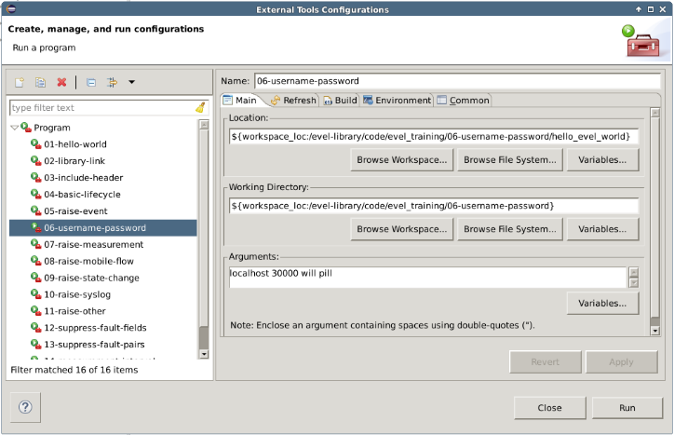
Eclipse Config

Slide 12
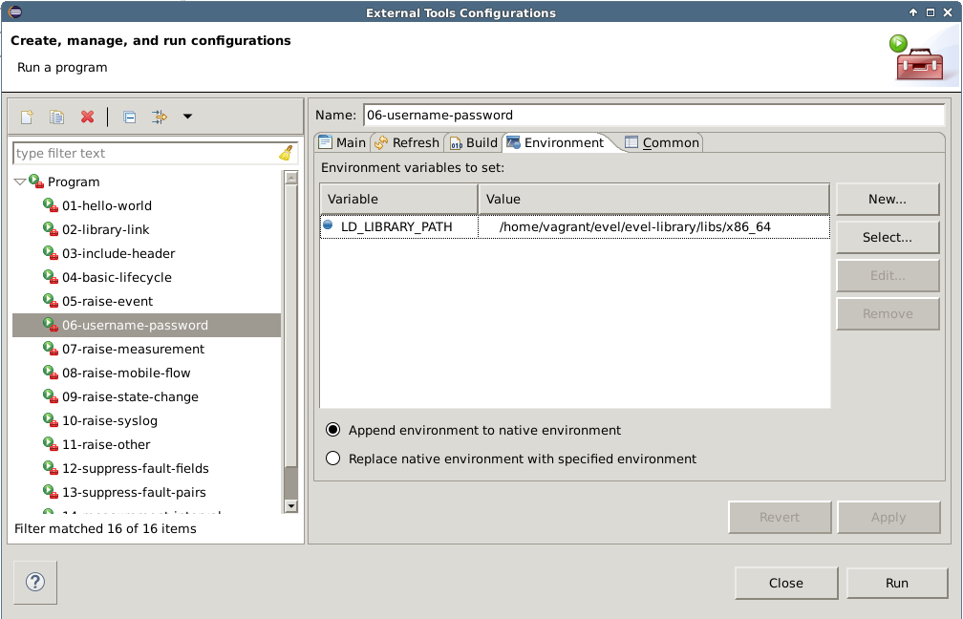
Eclipse Config

Slide 13
Test Control API
Test Collector has a new endpoint:
http://<fqdn>:<port>/testControl/v1.1/commandList
Usage:
Client POSTs a commandList to the test_collector.
test_collector receives and stores the commandList.
When test_collector receives the next event, it responds with the stored commandList and clears its local copy.
Manual usage:
> python test_control.py –-fqdn=192.168.0.10 –-port=30000
packaged with test_collector
Test usage:
evel_demo uses functions in “evel_test_control.c” to drive API.
evel_demo has a ‘-x’ option to stop it using the Test Control API.

Slide 14
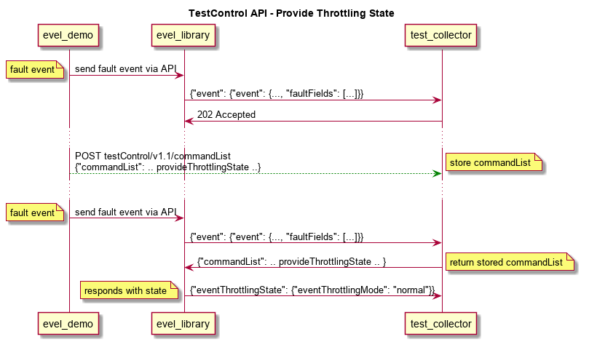
Test Control API
Test Collector has a new “Test Control” API
Test applications can post a commandList onto test_collector

Slide 15
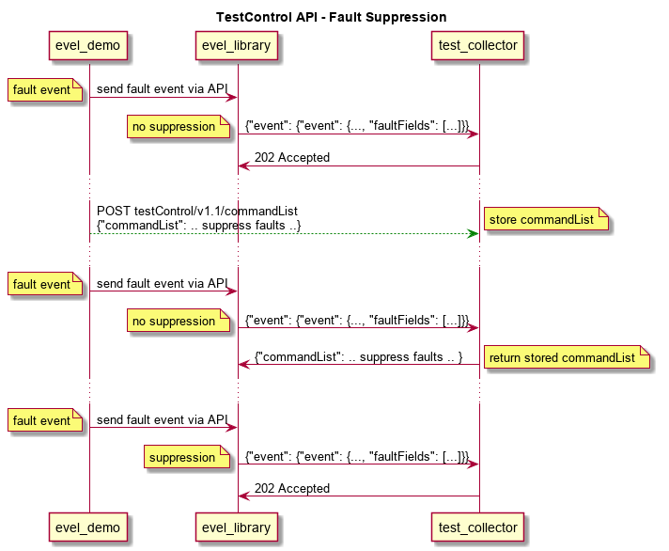
Test Control API – Fault Suppression

Slide 16
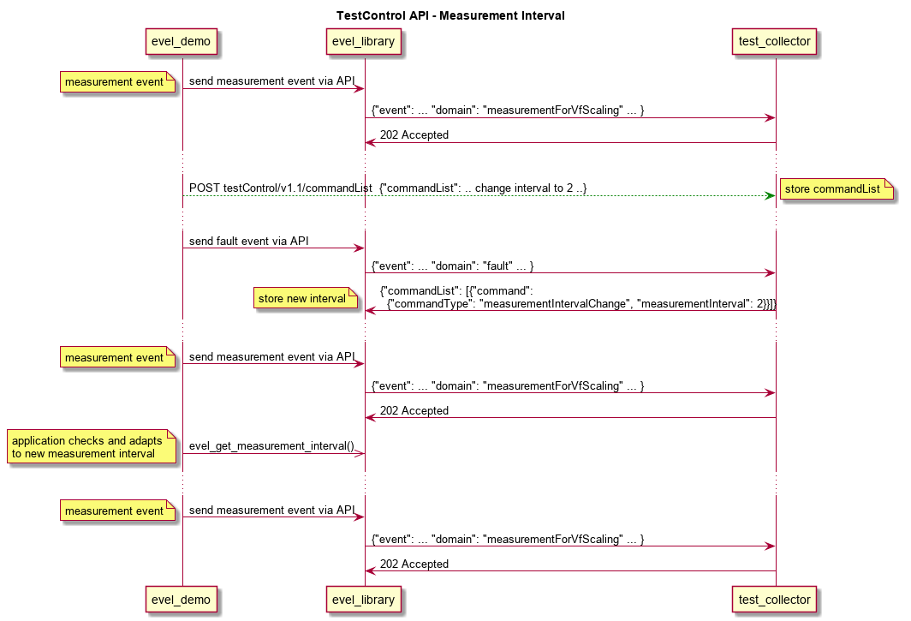
TEST CONTROL API – MEASUREMENT INTERVAL

